Slide 1
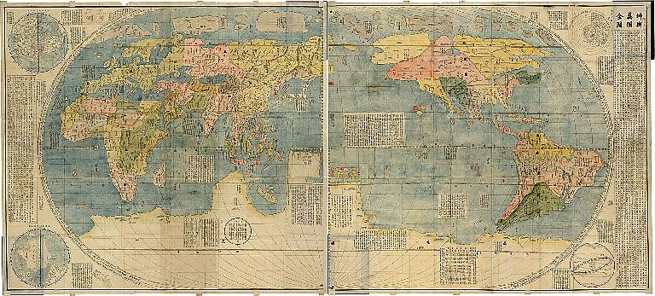
Medieval Europe
Do you already know anything about Medieval society??
Leave a page for your title page in your books ☺

Slide 2
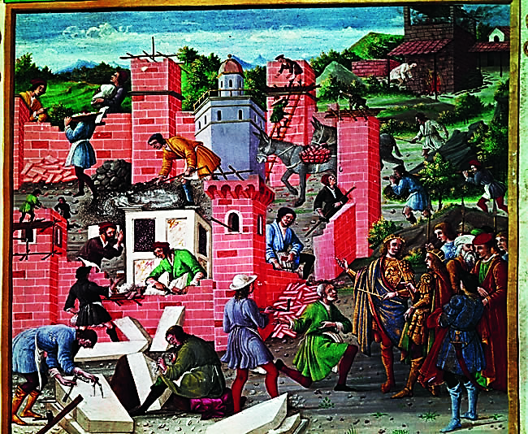
Write down at least FIVE activities you can see occurring in this picture.
What do you think they are building?

Slide 3
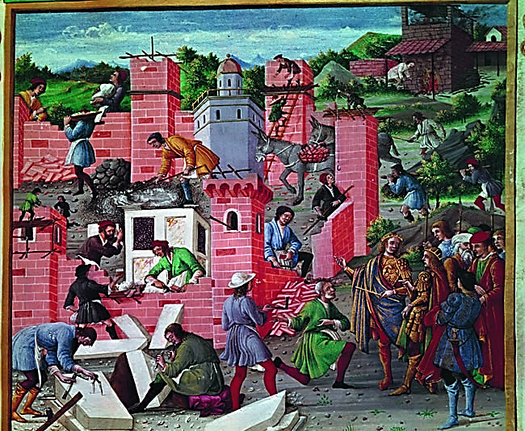
Medieval Europe
The medieval period lasted from about AD 500 to AD 1500. Medieval Europeans lived very different lives and had different attitudes, values and experiences from those of most people today.
As we explore this topic, we will find answers to these questions:
What can we learn about medieval European society?
What have been the legacies of this medieval society?

Slide 4
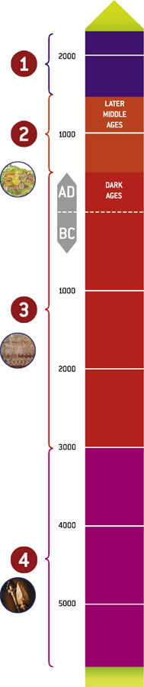
A timeline showing the three main periods of history
MODERN TIMES AD c.1500
MEDIEVAL TIMES AD 500 – AD c.1500
ANCIENT TIMES 3000 BC – AD c.500
PREHISTORY Before 3000 BC

Slide 5
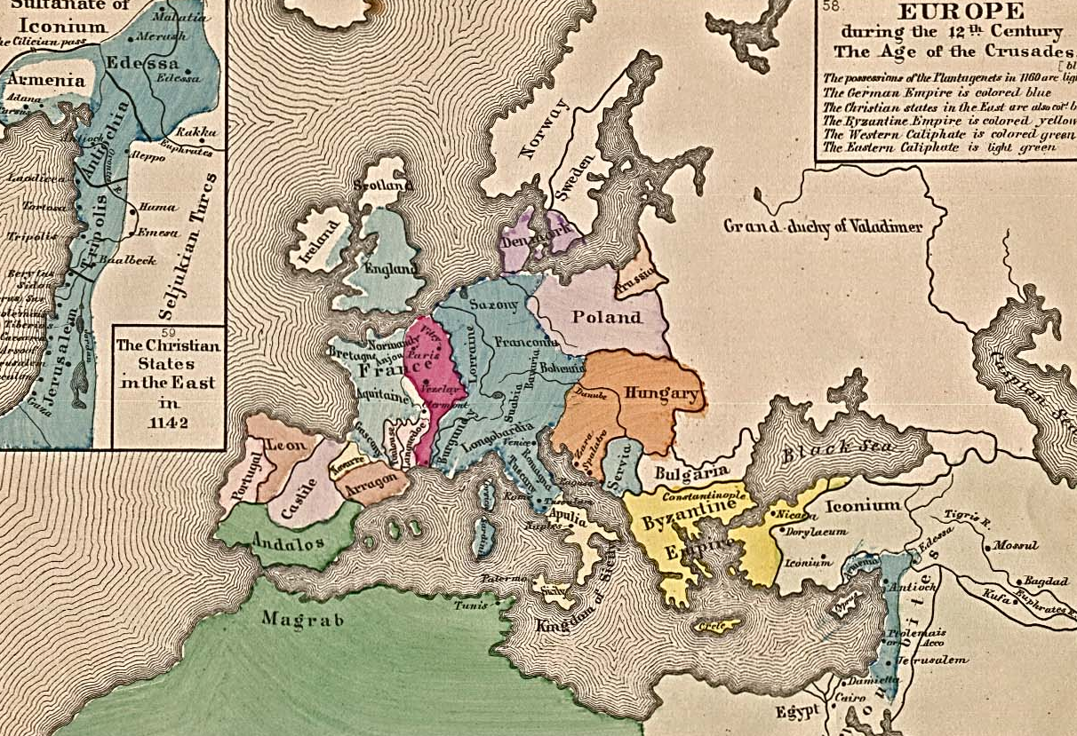
Christendom
the countries where Christianity was the main religious belief.

Slide 6
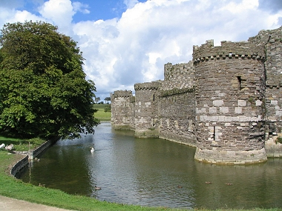
moat
a deep, wide ditch, built around a castle or town and filled with water.

Slide 7
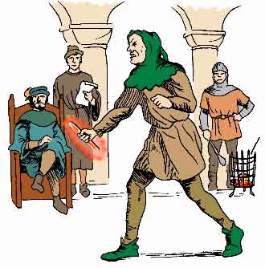
treason
the crime of not being loyal to the monarch (king or queen).

Slide 8
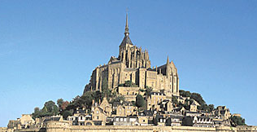
sanctuary
protection offered by the Church to those who confessed their crimes and promised to leave the country.

Slide 9
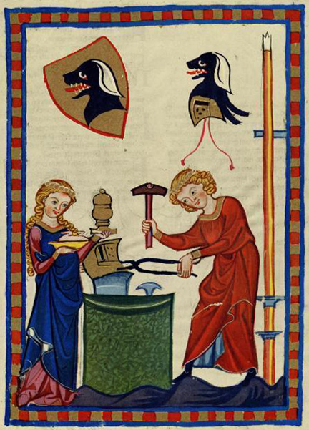
guild
a craft or trade organisation that set work standards for its members and offered them protection.

Slide 10
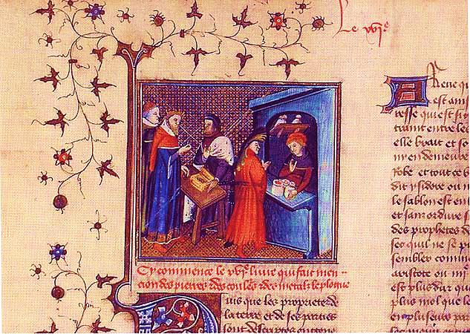
apothecary
a person who made a living by making and selling medicine and herbal remedies.

Slide 11
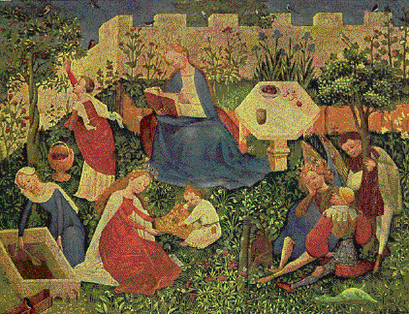
villein
peasant/villager under the control of the lord of the manor. The villein had to provide him with certain services e.g. farming, crafts, manual labour.

Slide 12
The word medieval comes from the Latin words medium aevum meaning ‘middle ages’.
The world of medieval Europe was a pre-industrial, largely agricultural world, controlled mainly by small groups dominated by men.
It was a world of superstition where witches caused illness, plague, drought, famine and crop failure.
The Catholic Church taught that the Earth was the centre of the universe and that the sun, planets and stars revolved around it.
Life was short and difficult.

Slide 13
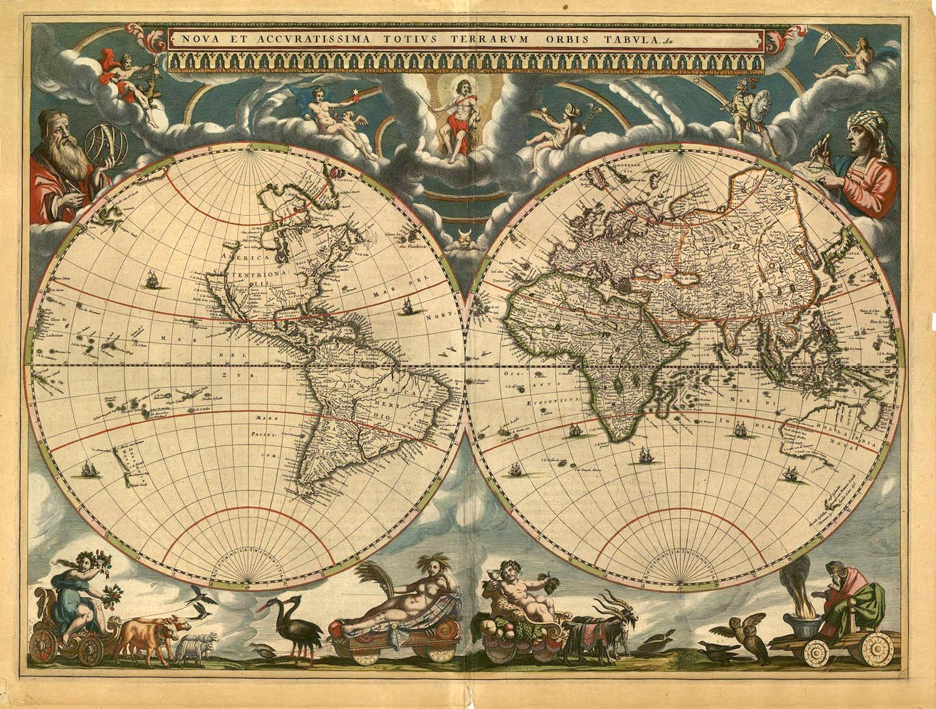
WHAT DID THE MEDIEVAL WORLD LOOK LIKE?
How is it different from our map of the world today? Is anything missing or different?

Slide 14
The words listed on the next slide are all about Medieval England. Copy the following tasks into your book:
Write lists of the words that you think could be grouped together.
Write a heading or title for each list.
Using writing or pictures, outline what you believe to be some key aspects of life in Medieval England.

Slide 15
Work in pairs and use these words to complete the task.
king knight
apprentice moat
queen joust
visor court
drawbridge weaving
castle nun
Vikings ploughing
spinning surgery
cathedral craftsman
priest squire
sewing merchant
blacksmith sword
conquest lance
disease horse
church rats
doctor Saxon
farming peasant
armour tournament
guild hunting
monastery village
baron plague
monk battle

Slide 17
